Slide 1
Human rights and gender equality

Slide 2
OUTLINE:
Right to life
Civil rights
Basic Rights
Right to reputation
Political & Economical rights
Women rights
Gender based discrimination
Rights of homosexuals
Conclusion

Slide 3
GENERAL PURPOSE:
To make people know about human rights and gender impartiality and inspire them to become valuable advocates for tolerance and peace.
SPECIFIC PURPOSE:
To show the vision of gender equality which is that every kind of gender has the same power to shape society and their own lives.
Students are the future of our nation. They must know about the types and the proper liabilities of human rights.

Slide 4
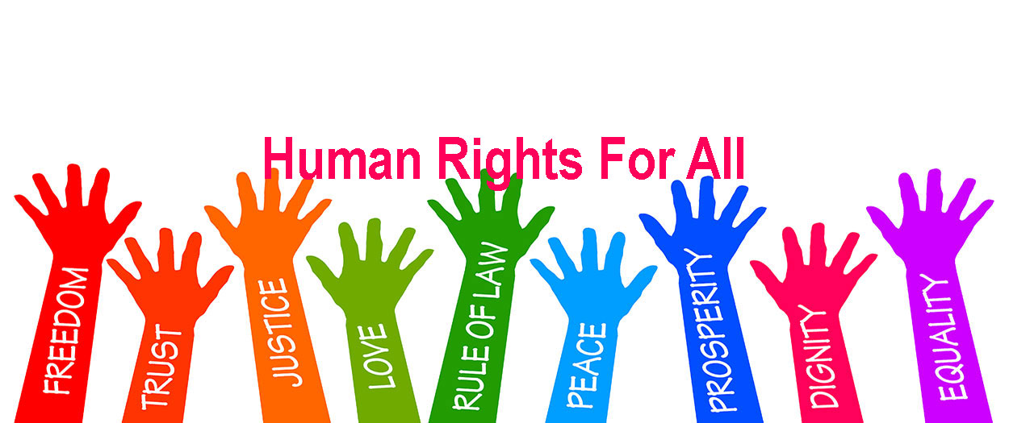

Slide 5
Right to Life:
The right to life is enshrined in Article 3 of the universal declaration of Human Rights. Every human being has the inherent right to life. The right shall be protected by law. No one shall be deprived of his life.
Civil Rights:
Civil rights refer to legal provisions that stem from notions of equality. Civil rights are not in the Bill of Rights; they deal with legal protections. For example , the right to vote is a civil right. A civil liberty, on the other hand, refers to personal freedom protected by the Bill of Rights.

Slide 6
Basic Rights:
Food , Clothing, Education, Accommodation, Medical treatment- these five elements are the fundamental rights since birth of a Man. These are the compulsory rights that have to be ensured when a child is born.
Right to Reputation:
The right to reputation Versus Freedom of Expression. Everyone has a right to his or her own good name and reputation . This is true because all human beings possess innate dignity that goes beyond our personal histories of success and failure, and our ethical or unethical actions.

Slide 7
Political Rights:
The rights that involve participations in the establishment or administration of a government and are usually held to entitle the adult citizen to exercise of the franchise, the holding of public office, and other political activities.
Economical Rights:
Economic, Social and Cultural Rights include the rights to adequate food, Adequate housing, To education, To health, To social security, To take part in cultural life , To water and sanitation, and to work.

Slide 8
Women Rights:
Women rights are the rights and entitlements claimed for women and girls of many societies worldwide.
In some places, these rights are institutionalized or supported by law, local custom, and behavior, where as in others they may be ignored or suppressed.
Women all over the world are being treated different than men.
Women’s rights activists have tried to get it to change and have traveled to many places to try and get more people to join their movement.

Slide 9
Gender Based Discrimination:
Discrimination based on gender is a common civil rights violation that takes many forms, including sexual harassment, pregnancy discrimination, and unequal pay for women who do the same jobs as men. Unfortunately, most Bangladeshi women are all too familiar with all of these inequalities. This section offers in depth information on unlawful gender discrimination in a number of settings including employment and education. Gender discrimination laws also protect the rights to transgender individuals.

Slide 10
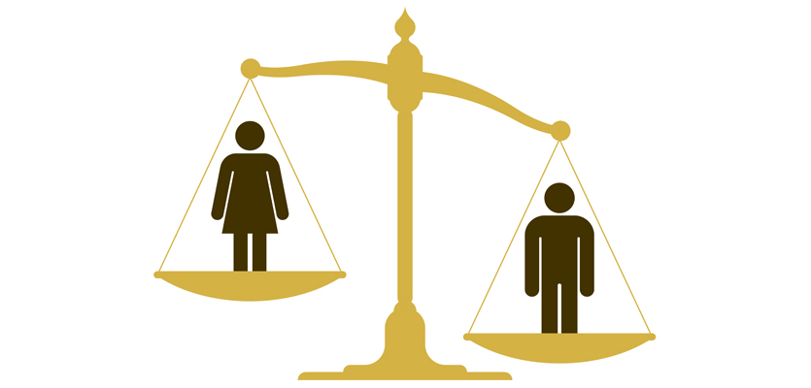

Slide 11
Many women rights activists work to get women their rights. While women somehow can have the support of activists and organizations, on the other hand men don’t have that backbone. They need to do the stuffs regarding their rights and existence all by themselves. So, from that perspective, men are also discriminated sometimes to an extent.

Slide 12
Rights of Homosexuals:
Human rights are basic individual rights, which cannot be reduced. They are valid for inhabitants without discrimination on the basic of race, disability, gender, sexual orientation , religion, age or national or ethic origin. All over the world LGBT rights are being violated.
Though many countries have approved the law of homosexual rights, the constitution of our country has not drawn attention to these rights effectively yet. As a result, LGBT people of our country are being discriminated because they can’t talk about their real identities and proper rights.

Slide 13
Conclusion:
Human rights are rights relating to life, liberty, equality and dignity of the individual guaranteed by constitution of any country. Before that every person needs to understand the value of his or her right as a human being and fight for it if needed. Our purpose to talk about those points to conclude main ideas of human rights.
Gender equality is must in any social and national platform. One is confident to present himself or herself when he or she knows the value of his or her existence. Our purpose to talk about gender equality not only to discuss equality between men and women but also to set equation of rights among homosexual and heterosexual people.

Slide 14
THANK YOU EVERYONE

